Slide 1


Faculty of Computing and Informatics
Department of Computer Science
IT Infrastructure Administration and Services
ITA711S
2023 - Semester 1
Event Specific Picture – behind red graphic
Chapter 4
Daemons and Services – Part 2

Slide 2
Outline
Service and port monitoring
Analysing port scan reports
Processes (daemons)
Run levels
Chaining daemon configuration

Slide 3
Service and port monitoring
Daemons can be used to detect, fix and alert problems
Two types of monitoring
  Real-Time
    Has a monitoring component that notices failure/error and an alerting component that alerts someone.
    E.g. daemons are in place to alert administrators before clients notice.
  Historical
    Viewing of logs
    Polling systems at intervals
    Can produce graphs of system performance
Standard mechanisms are ICMP pings, TCP and SNMP

Slide 4
Analysing port scan reports
Think of port scanning as ringing a doorbell to see if someone is home.
Analyzing entries might be a little too late if intruder already entered, but could prepare you for next time.
Poorly configured hosts are vulnerable to attacks, usually the owner are not aware of services that are running on their system
Analyzing untimely port scans might help in preventing intrusions.

Slide 5
Analysing port scan reports
Windows
  Event viewer
    Allows system logs to be viewed, and analyzed.
    Can view strings of connect requests
Linux
  Syslogd and Klogd
    Its a syslog daemon used to capture log messages. The syslogd daemon is has a klogd application which is used to capture and log kernel messages.
    The syslog daemon can be configured through the /etc/syslog.conf config file.
Analyzing port scans should include analyzing the firewall logs

Slide 6
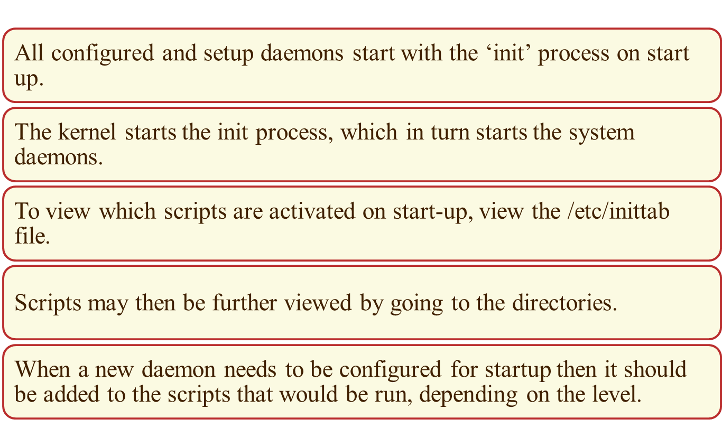
Processes (Daemons)

Slide 7
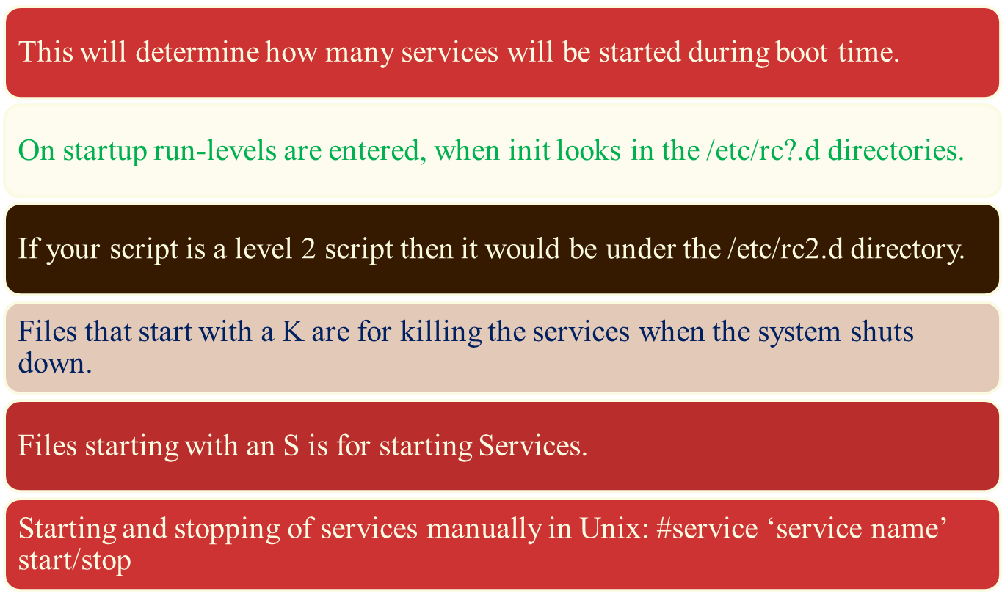

Run Levels

Slide 8
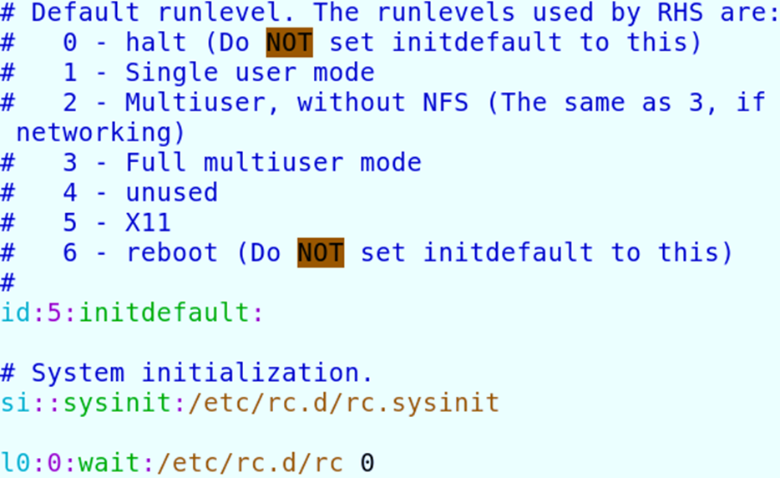
Run Levels

Slide 9
Changing your daemon configuration
View list of running daemons
        ps –ef
Make a note of daemon to configure
Look for your configuration file under /etc, usually ends with .conf or .cf.
Your file should be something like
        daemonname.conf
Backup your file before making changes, for reverting back if any problems arise.
Edit your file, make changes then save file.

Slide 10
Changing daemon configuration
Check in /etc/initd directory, locate control script for the daemon, also make a copy of original run script.
Edit control script and options as described in manual of daemonname
Restart the daemon
  /etc/init.d/daemonname stop
  /etc/init.d/daemonname start
Make sure if daemon has started by typing in ps –ef|grep daemonname

Slide 11

End

